Slide 1
WildFire Hackathon
Cedar Bend

Slide 2
Backgrounds
Aania Shah & Bilal Khan Data Science
Maanav Rajesh Software Engineering
Aaditya Lanke Finance/Consulting
Aaryaman Bhageria Quantum Computing

Slide 3
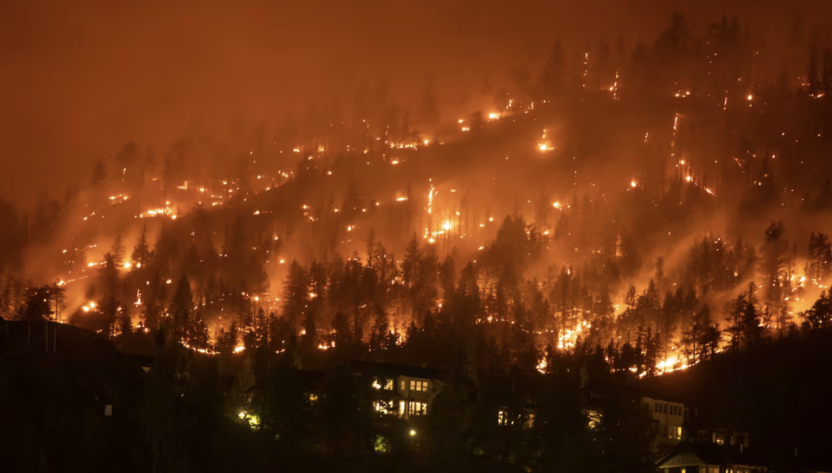
Hackathon Motivations
Interest stemmed from personal experience last fall in Kelowna.
A close friend had a harrowing experience of evacuating his home.
Rapid velocity of spread enabled embers to jump over a wide stream, bypassing a protective barrier.
Devastation and chaos inflicted on the communities created by the wildfires was immense.

Slide 4
Exploratory Study on Data
Explored existing research on wildfire spread in North America to identify relevant factors and data
Leveraged existing wildfire simulation tools to experimentally understand how they spread
Manipulated fire simulation variables to discover potential explanatory variates

Slide 5
Simulation

Slide 6
Insights on the Explanatory Variates
Our research led us to the following factors had the largest impact:
Relative Humidity
Elevation
Temperature
Wind Speed/Direction
Precipitation
Fuel content

Slide 7
Design Process
conv_block2:
First Conv2d layer:
Input channels: 16
Output channels: 8
Kernel size: 3x3
Bias: Yes (1 parameter per output channel)
Batch normalization: Yes (2 parameters per output channel)
Second Conv2d layer:
Input channels: 8
Output channels: 1
Kernel size: 3x3
Bias: Yes (1 parameter per output channel)
conv_block1:
First Conv2d layer:
Input channels:
Output channels: 8
Kernel size: 3x3
Bias: Yes (1 parameter per output channel)
Batch normalization: Yes (2 parameters per output channel)
Second Conv2d layer:
Input channels: 8
Output channels: 16
Kernel size: 3x3
Bias: Yes (1 parameter per output channel)
Batch normalization: Yes (2 parameters per output channel)
conv_block_middle:
First Conv2d layer:
Input channels: 16
Output channels: 32
Kernel size: 3x3
Bias: Yes (1 parameter per output channel)
Batch normalization: Yes (2 parameters per output channel)
Second Conv2d layer:
Input channels: 32
Output channels: 16
Kernel size: 3x3
Bias: Yes (1 parameter per output channel)
Batch normalization: Yes (2 parameters per output channel)
3 CNN blocks:
Implemented L1 Reg, Dropout reg and Early stopping
Attempted to use an ensemble model CNN w/ features and another for forecasting stochastic features
Tried different model structures CNN, Logistic Regression Model and Random Forest
Prevent overfitting despite adding an additional layer using L1 and dropout to help it

Slide 8
Scalability & Model Footprint
Model can be trained in under 20 epochs
Under 5 minutes to train; 12777 neurons.
Relatively small model
Easy to understand, small number of parameters
Room for improvement
Hyperparameter Tuning
Temporal Model (segmented)

Slide 9
Bibliography
https://neurips.cc/virtual/2023/poster/73593
https://cs229.stanford.edu/proj2019aut/data/assignment_308832_raw/26582553.pdf
https://ieeexplore.ieee.org/stamp/stamp.jsp?arnumber=9840400
https://manuelemacchia.com/forest-fires/
https://earthobservatory.nasa.gov/images/148789/climate-change-pushes-fires-to-higher-ground

Slide 10
THANK YOU

